Slide 1
CEF440: INTERNET PROGRAMMING AND MOBILE PROGRAMMING
TASK II: REQUIREMENT GATHERING
Presented by Group 11

Slide 2
What is requirement gathering
Requirement gathering is the process of identifying your project’s exact requirements from start to finish.
How long will our project schedule be?
Who will be involved in the project?
What risks may we face in this project?
Studying the current system

Slide 3
Project Initiation document(PID) and PID Template(1/2)
A project initiation document (PID) is a type of document that project managers create before they begin a project.
A project initiation document (PID) template is a reusable outline of a project initiation document.

Slide 4
Project Initiation document(PID) and PID Template(2/2)
Why use the PID template
Establishes consistency across all projects.
Allows for customization for specific teams.
Quickly provide context for stakeholders
What’s included in a project initiation document template?
Project goals or objective
Success metrics
Project scope
Communication plan
Resourcing strategy

Slide 5
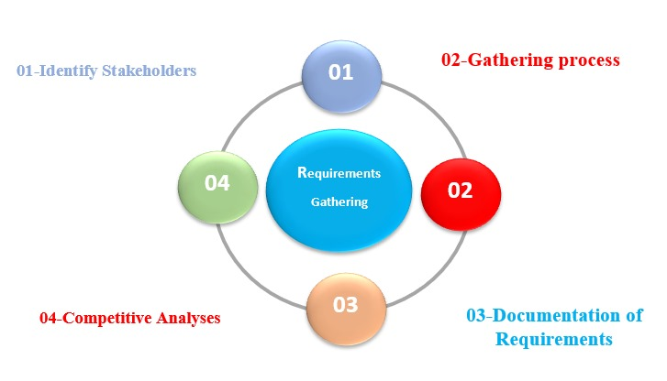

Slide 6
Requirement gathering
Identify stakeholders
Administration
Teachers
Students
IT Department

Slide 7
Requirement gathering
Gathering Techniques(1/6)
Paper-Based Questionnaires: Questionnaires are an effective tool for gathering data from a large sample of stakeholders in a structured manner.
There are many considerations to be made such as:
Developing a clear and concise set of questions that are relevant to the research objectives.
Choosing the appropriate distribution channels based on the target audience which is the paper-based questionnaire.
Below is a sample questionnaire answered for our Biometric attendance system.

Slide 8
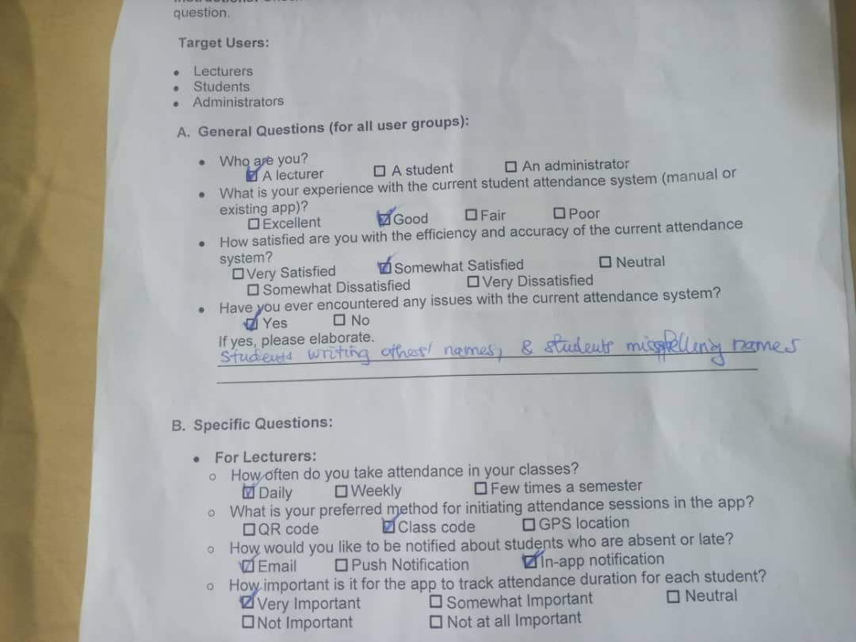

Slide 9
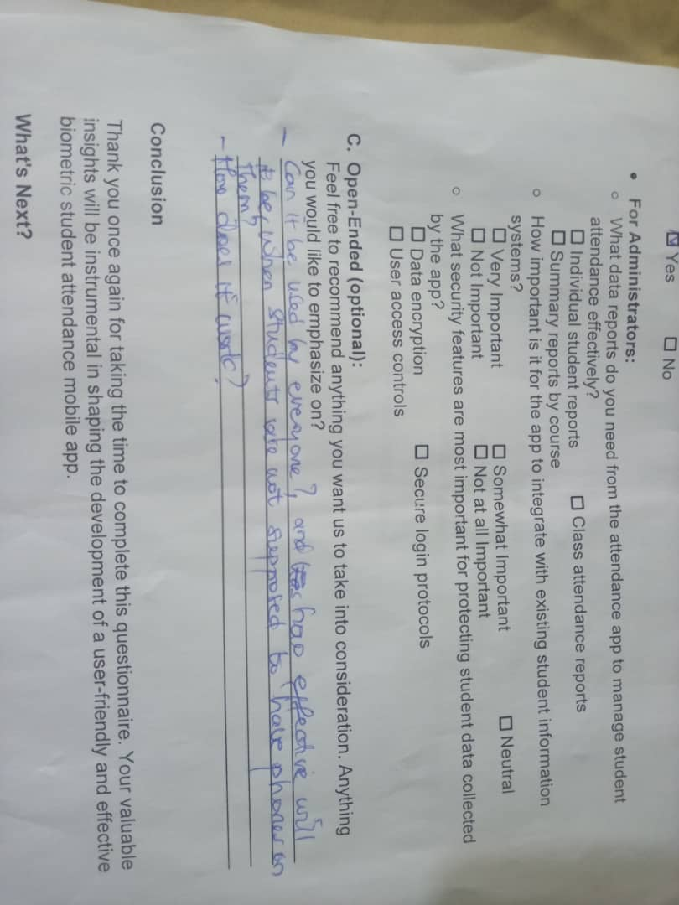

Slide 10

Requirement gathering process Gathering Techniques(2/6)
Conducting user interviews: Conducting one-on-one interviews with stakeholders allows for in-depth exploration of their needs, preferences, and challenges.

Slide 11
Requirement gathering process
Gathering Techniques(3/6)
Google Form Surveys: We collected the following information and obtain some questions like:
Does your faculty currently has a student attendance system in place?
If yes, what type of system is currently used?
How satisfied are you with the system?

Slide 12
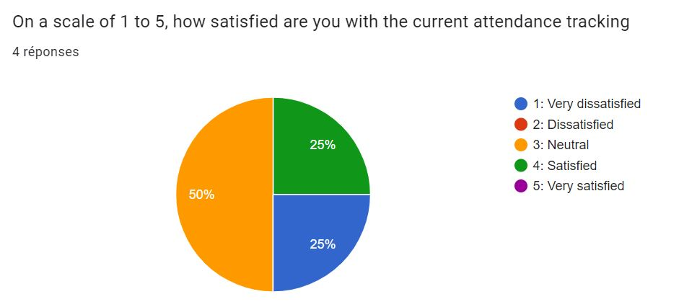
Sample question
How satisfied are you with the system?

Slide 13
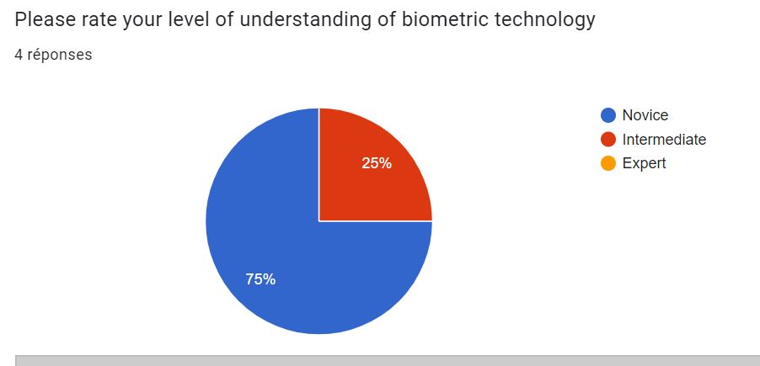
Sample question
How well do you understand a biometric technology?

Slide 14
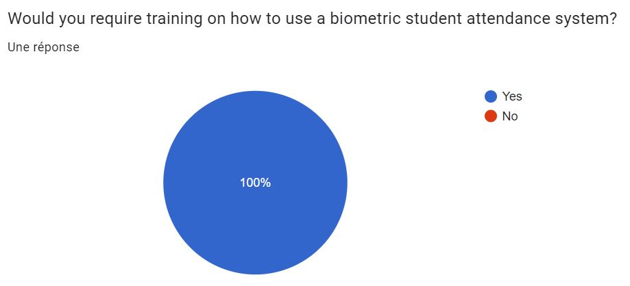
Sample question
Would you like to receive training on a biometric attendance system?

Slide 15

Requirement gathering process Gathering Techniques(4/6)
Workshop: Workshops are brainstorming sessions between developers and stakeholders.
Fig: Vector image of stakeholders and developers at workshop.

Slide 16
Requirement gathering process
We were able to come up with requirements such as:
Enrollment module
Attendance recording module
Reporting and Monitoring module
Student conduct and performance module

Slide 17

Requirement gathering process(3/5) Gathering Techniques(5/6)
Shadowing: shadowing is acting or putting yourself in another one position to mimic his/her views or reactions.

Slide 18
Requirement gathering process
We were able to come up with requirements such as:
Accompanying instructors
Following students

Slide 19
Requirement gathering process(3/5)
Gathering Techniques(6/6)
Competitive Analysis we conducted benchmarking and competitive analysis to gather insights from existing solutions in the market.
Some existing solutions in the market are:
Deputy
N-check
Master Soft
jibble

Slide 20
Requirement gathering process
Requirement Documentation
Documenting requirements is a crucial step in the software development process, ensuring that all stakeholders have a clear understanding of what needs to be built and how it will function.
Use cases
User stories

Slide 21
Conclusion
By following these steps, you'll have a solid foundation of user needs and functionalities to guide the development of your biometric student attendance mobile app.

Slide 22
THANK YOU

